Slide 1
UNIT – IV MICROCONTROLLERS – 8051
.

Slide 2
CONTENTS
• Introduction.
•
Microcontroller vs Microprocessor.
• Architecture.
• Pin diagram.
• Pin configuration.
•
Memory Organisation.
• Applications.

Slide 3
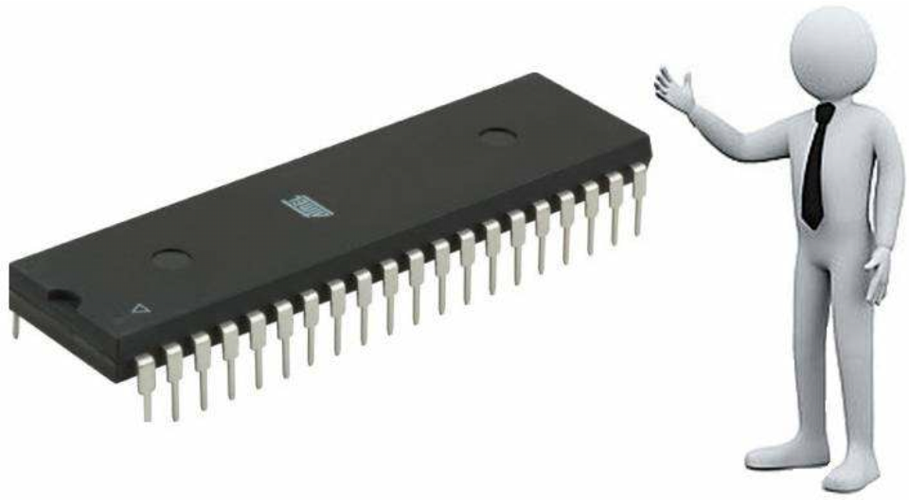
INTRODUCTION
Def: A single chip computer or A CPU with all
the peripherals like RAM, ROM, I/O, Timers,
ADCs, etc on the same chip.
OR
Def : A microcontroller is meant to be more self-
- contained and independent, and functions
as a tiny, dedicated computer.
4

Slide 4
Def: A microcontroller is a small, low-cost and self contained computer-on-a-chip that can be used as an embedded system.
A few microcontrollers may utilize four-bit expressions and work at clock rate frequencies, which usually include:
An 8 or 16 bit microprocessor.
A little measure of RAM.
Programmable ROM and flash memory.
Parallel and serial I/O.
Timers and signal generators.
Analog to Digital and Digital to Analog conversion

Slide 5
FEATURES OF 8051
• useful for small computing tasks.
•
adequate for many control and monitoring
application.
• packaging(RAM,ROM,Timers on-chip).
• Less power consumption.
• Easily upgradable.
• Cost per unit is less.
• Availability of tools of microcontroller
such as proteus(simulator) and keil(compiler).

Slide 6
MICROPROCESSOR vs
MICROCONTROLLER
• General purpose device.
•
single chip computer.
•
do not contain on-chip
•
it includes RAM ,ROM
I/O ports, Timers, ADC
,Timers, ADC, DAC,
Memory etc.
interrupts etc.
•
used as CPU in computer.
•
performs control oriented
•
design is complex and
applications.
expensive.
•
simple and less expensive
•
it has zero status flag.
Eg: 8086, 8087, 8088 etc
•
it has no zero flag.
Eg: Altera, Atmel, 8051 etc

Slide 7
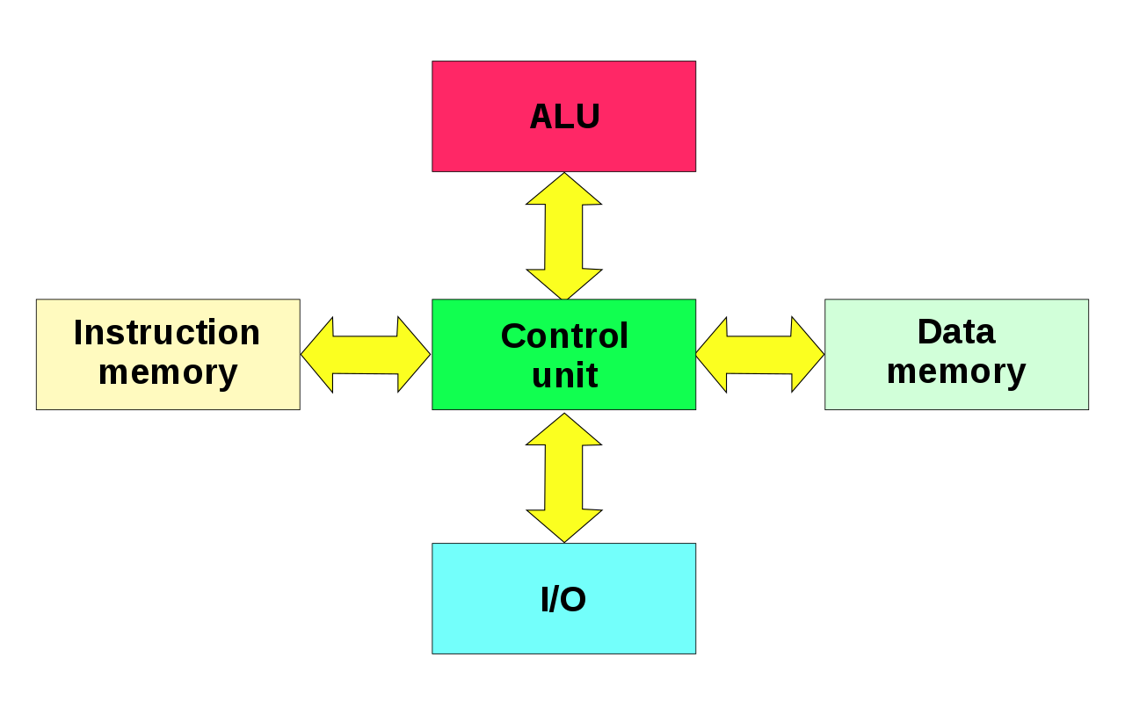
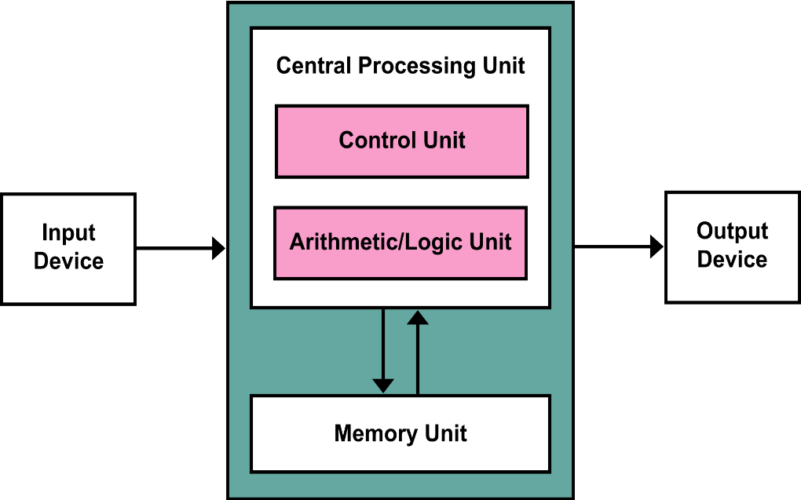
TYPES OF ARCHITECTURES
Microcontrollers can use TWO basic design models:
1. Harvard Architecture
RISC Microcontrollers
Separate data and instruction
buses
Transfers to be performed
simultaneously on both buses.
2. Von-Neumann architecture.
CISC Microcontrollers
Only one bus
used for both data transfer and
instruction fetches

Slide 8
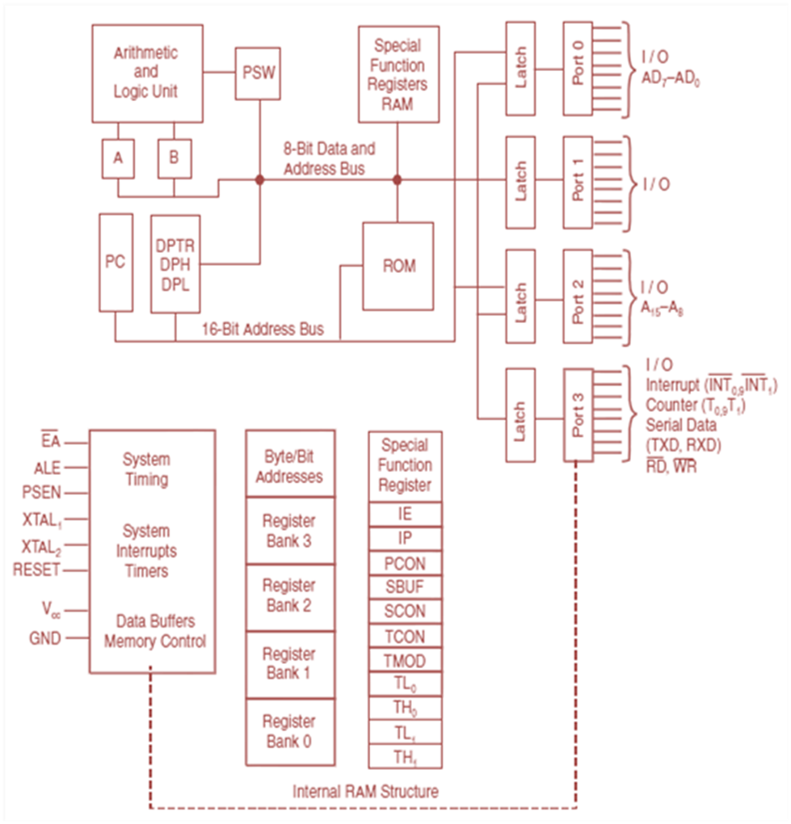
Architecture
1F
2F
00
20

Slide 9
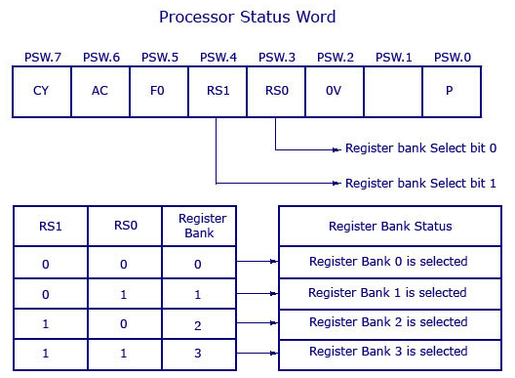
To remember the PSW of 8051:
“ CAFR² O- P “

Slide 10
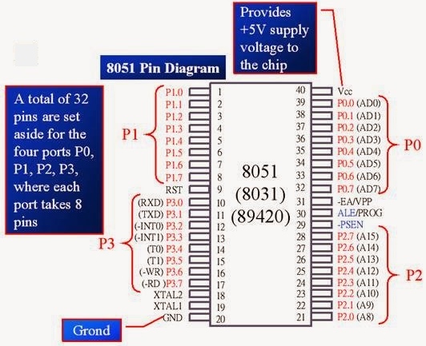
Pin Diagram and configuration

Slide 11
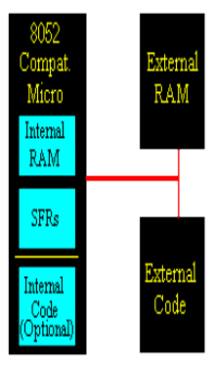
MEMORY ORGANISATION
1. Code Memory
2. External RAM
3. On-Chip Memory
4. Internal RAM
5. Special Function Register

Slide 12
1. Code Memory
❑ holds the actual 8051 program.
❑ limited to 64K.
❑ may be both internal or external.
2. External RAM
❑ slow accessing speed.
❑ it gains in quantity.
❑ limited to 64K.

Slide 13
3. On-Chip Memory
❑ It refers to that memory that physically exists
on the microcontroller itself.
❑ Two types-
a) Internal RAM
b) SFR (Special Function Register)
❑ Total 256 bytes.
❑ Equal memory for RAM and SFR i.e 128bytes.

Slide 14
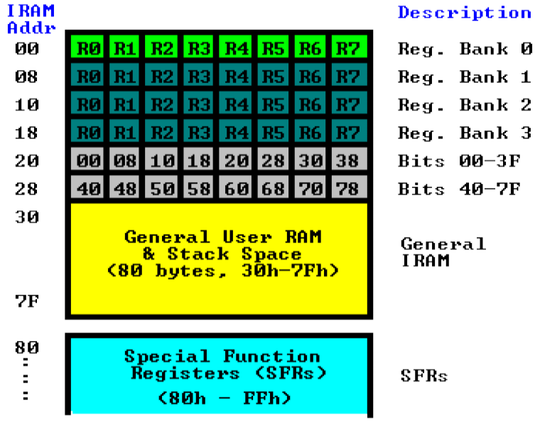
4. INTERNAL RAM:

Slide 15
5. SPECIAL FUNCTION REGISTER (SFR’s)
➢Accumulator.
➢B Register.
➢Program Status Word.
➢Stack Pointer.
➢Data Pointer.
➢Ports 0 to 3.
➢Timer Registers.
➢Control Register.

Slide 16
APPLICATION OF 8051
➢Automobile.
➢Rail Transport.
➢Industrial Processing.
➢Remote sensing.
➢Robotics.
➢Consumer electronics.
➢Security(e-commerce and smart cards).
➢Medical.
➢Defense application.

Slide 17
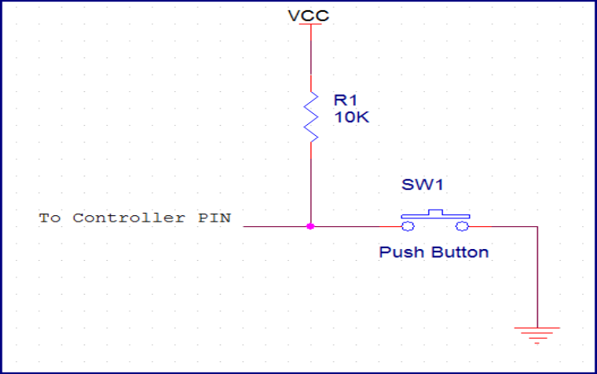
SWITCH INTERFACING

Slide 18
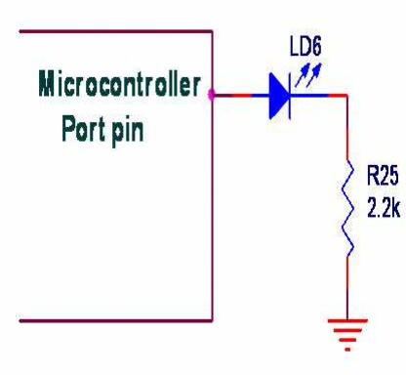
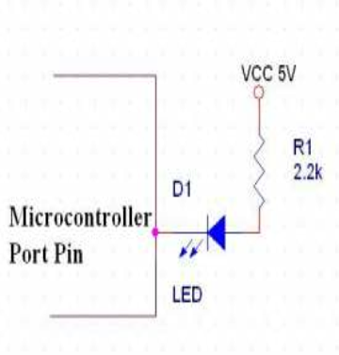
LED INTERFACING

Slide 19
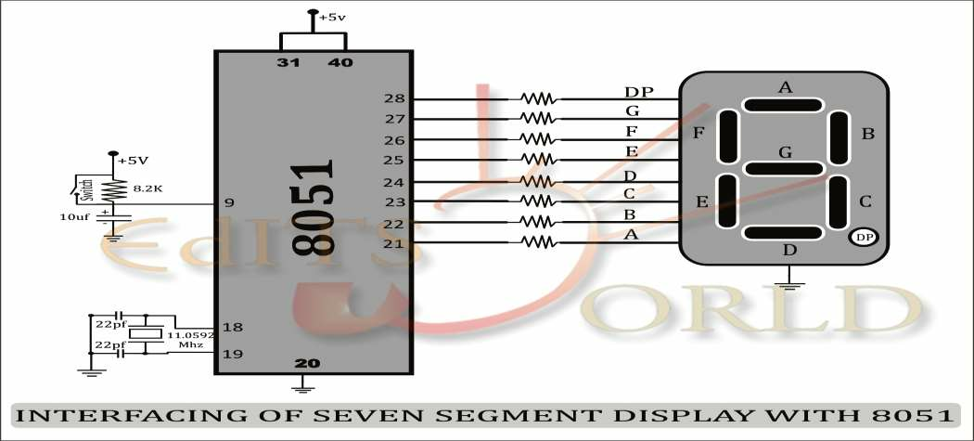
7- SEGMENT INTERFACING

Slide 20
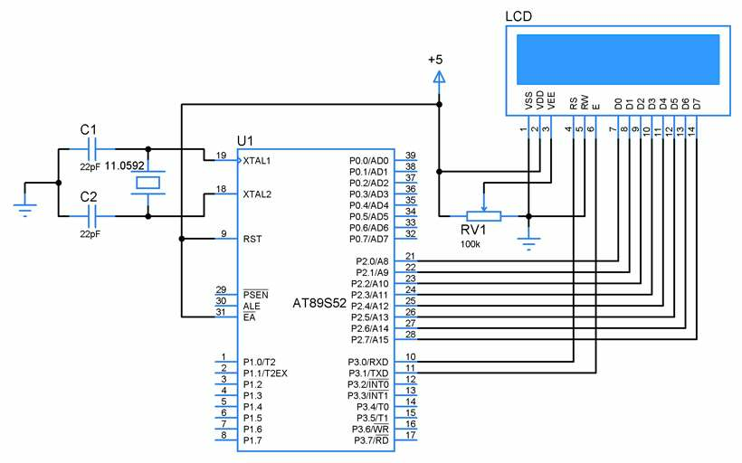
LCD INTERFACING

Slide 21
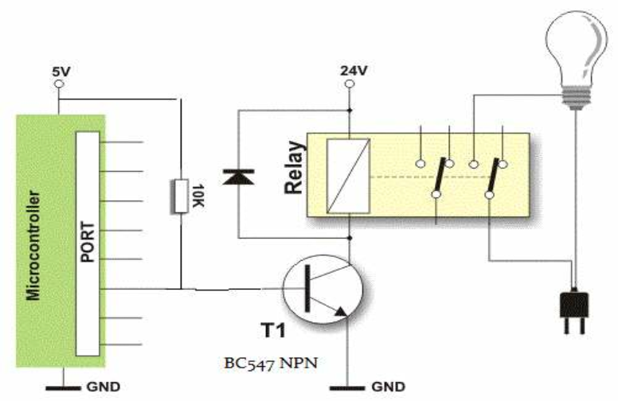
RELAY INTERFACING

Slide 22
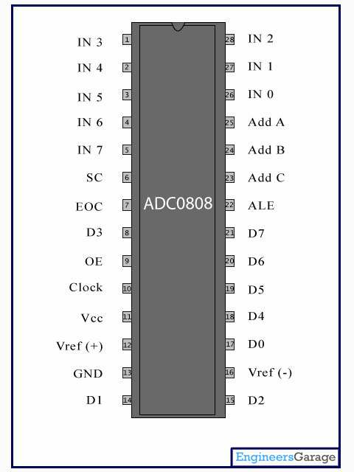
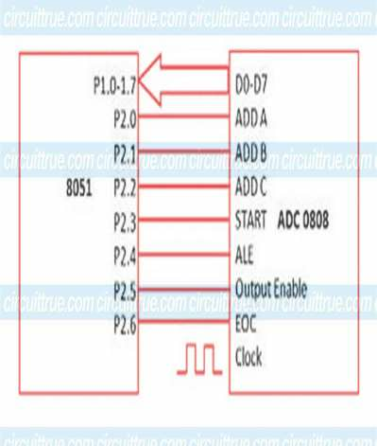
ADC INTERFACING

Slide 23
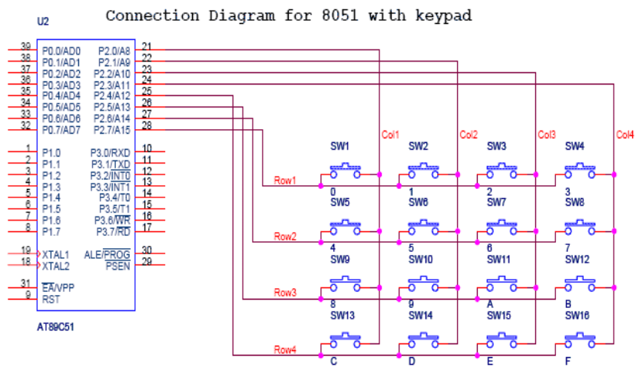
MATRIX KEYPAD INTERFACING

Slide 24



Slide 25
8051 Addressing Modes

Slide 26
What is an addressing mode ?
Addressing mode is a way to address an operand.
 In other words, access data are modes.
various ways to called addressing
Operand means the data we are operating upon (in most cases source data).
It can be a direct address of memory, it can be register names, it can be any numerical data etc.

Slide 27
Addressing Modes
8051 provides a total of five distinct addressing modes.
1. Immediate
2. Register
3. Direct
4. Register indirect
5. Indexed

Slide 28
1. Immediate Addressing Modes
If the operand is a constant then it can be stored in memory immediately after the opcode.
immediate addressing is only of use when the data to be read is a constant
if your program needed to perform some calculations based on the number of weeks in the year, you could use immediate addressing to load the number 52 (34H) into a register and then perform arithmetic operations upon this data
Ex::: : MOV R0, #34 (2 byte instruction)

Slide 29
Immediate Addressing Mode ( Conti..)
The above instruction is an example of immediate addressing. It moves the data 34H into R0
The assembler must be able to tell the difference between an address and a piece of data
It has symbol (#) is used for this purpose (whenever the assembler sees # before a number it knows this is immediate addressing)

Slide 30
2. Register Addressing Mode
Often we need to move data from a register into the accumulator so that we can perform arithmetic operations upon it
For example, we may wish to move the contents of R5 into the accumulator.
Example-1: MOV A, R5
This is an example of register addressing.
It moves data from R5 (in the currently selected register bank) into the accumulator.
Example-1: ADD A, R6

Slide 31
3. Direct Addressing Mode
Note: Direct addressing mode is used for accessing data in the
on-chip RAM
Examples:
a) MOV R0, 40H ; save content of RAM location 40h in R0 register
b) MOV 56H, A ; save content of A in RAM location 56H
c) MOV A, 4 ;
MOV A, R4 ;
Applicable only for RB0 registers. Since RAM location are 0 to 7 for R0 to R7 respectively of Register Bank 0

Slide 32
4. Register Indirect Addressing Mode
Register addressing and direct addressing both restrict the programmer to manipulation of data in fixed addresses
The address the instruction reads from
(MOV A, 30H) or writes to (MOV 30H,A) cannot
be altered while the program is running.
There are times when it is necessary to read and write to a number of contiguous memory locations

Slide 33
Register Indirect (Conti..)
For example, if you had an array of 8- bit numbers stored in memory, starting at address 30H, you may wish to examine the contents of each number in the array (perhaps to find the smallest number)
To do so, you would need to read location 30H, then 31H, then 32H and so on 37H
It Can be achieved by using Register Indirect .

Slide 34
Register Indirect (Conti..)
To access the more than one element form the memory , we use indirect addressing
R0 and R1 may be used as pointer registers
Example: MOV A, @Ri
where Ri is either R0 or R1

Slide 35
Register Indirect (Conti..)
 Now, we can read the contents of location
30H through indirect addressing
MOV R0, #30H
MOV A, @R0
The first instruction is an example of immediate addressing whereby the data 30H is placed in R0
The second instruction is indirect addressing. It moves the contents of location 30H into the accumulator.
Now, If we wish to get the data in location 31H we use the following:
INC R0
MOV A, @R0 ;This is just like the Pointers in C.

Slide 36
5. Indexed Addressing Mode
The data elements are stored in the program(code) memory.
Instructions MOVC and JMP are used instead of MOV
It is widely used in accessing data elements of look up table entries located in the program ROM space of 8051.
The address of memory is indexed i.e. added to form the actual address of memory.
Example: MOVC B, @A+DPTR => here 'C' means Code.
The content of A register is added with content of DPTR and the resultant is the address of memory location from where the data is copied to A register.

Slide 37
Problem
Write an assembly language program for moving the data starting from memory location 40H to 49H to accumulator and store the same into memory location from 50H to 59H.

Slide 38

Any Questions

Slide 39
Instruction set of 8051

Slide 40
Agenda:
Instruction
Instruction Format
Types of instructions

Slide 41
Instruction:
Instruction consists of an Opcode (Operation – Code) followed by Operand(s) of size Zero Byte, One Byte or Two Bytes.
Eg. MOV A, B
(Opcode Operands)
The Op-Code part of the instruction contains the Mnemonic, which specifies the type of operation to be performed. All Mnemonics or the Opcode part of the instruction are of One Byte size.

Slide 42
Operands:
It defines the data being processed by the instructions. The operand can be any of the following:
No Operand
Data value
I/O Port
Memory Location
CPU register

Slide 43
INSTRUCTION FORMAT
MNEMONIC (DESTINATION OPERAND), (SOURCE OPERAND);
Ex: MOV A, B
Types:
One-byte instruction, which contains only opcode,
Two-byte instructions, where the second byte is the operand
Three byte instructions, where the operand makes up the second and third
byte.

Slide 44
Types of Instruction Sets
Based on the operation they perform, all the instructions in the 8051 Microcontroller Instruction Set are divided into five groups.
They are:
Data Transfer Instructions
Arithmetic Instructions
Logical Instructions
Boolean or Bit Manipulation Instructions
Program Branching Instructions

Slide 45
1. Data Transfer Instructions
The Data Transfer Instructions are associated with transfer with data between registers or external program memory or external data memory.
The Mnemonics associated with Data Transfer are given below.
MOV
MOVC
MOVX
PUSH
POP
XCH
XCHD

Slide 46
2. Arithmetic Instructions
These are used to perform addition, subtraction, multiplication and division.
These include the instructions like increment by one, decrement by one and a special instruction called Decimal Adjust Accumulator.
The Mnemonics associated with the Arithmetic Instructions are :
ADD
ADDC
SUBB
INC
DEC
MUL
DIV
DA A
Arithmetic instructions affect carry, auxiliary carry ,overflow, zero and sign flags in the PSW Register.

Slide 47
3. Logical Instructions
Theses perform logical operations like AND, OR, XOR, NOT, Rotate, Clear and Swap.
Logical Instruction are performed on Bytes of data on a bit-by-bit basis.
Mnemonics associated with Logical Instructions are :
ANL
ORL
XRL
CLR
CPL
RL
RLC
RR
RRC
SWAP

Slide 48
4. Boolean or Bit Manipulation Instructions
Boolean or Bit Manipulation Instructions will deal with bit variables.
There is a special bit-addressable area in the RAM and some of the Special Function Registers (SFRs) are also bit addressable.
Mnemonics associated with Boolean or Bit Manipulation instructions are:
CLR
SETB
MOV
JC
JNC
JB
JNB
JBC
ANL
ORL
CPL

Slide 49
5. Branch Instructions
These instructions control the flow of program logic
The mnemonics of the Program Branching Instructions are as follows.
LJMP
AJMP
SJMP
JZ
JNZ
CJNE
DJNZ
NOP
LCALL
ACALL
RET
RETI
JMP
Note: 1. All these instructions, except the NOP (No Operation) affect the Program
Counter (PC) in one way or other.
2. Some of these instructions has decision making capability before transferring
control to other part of the program.

Slide 50
QUESTIONS

